Slide 1
Fair use notice
The material used in this presentation i.e., pictures/graphs/text, etc. is solely intended for educational/teaching purpose, offered free of cost to the students for use under special circumstances of Online Education due to COVID-19 Lockdown situation and may include copyrighted material - the use of which may not have been specifically authorized by Copyright Owners. It’s application constitutes Fair Use of any such copyrighted material as provided in globally accepted law of many countries. The contents of presentations are intended only for the attendees of the class being conducted by the presenter.

Slide 2
OBJECT ORIENTED PROGRAMMING
Presented by: Engr. Mariam Memon

Slide 3

Table of contents
Arrays
Multi-Dimensional Arrays

Slide 4
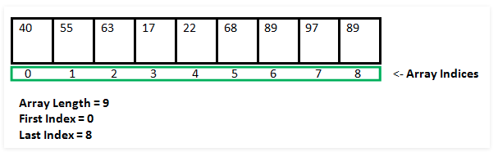
Arrays
An array is a container that holds data (values) of one single type.
For example, you can create an array that can hold 100 values of int type.
Array is a fundamental construct in Java that allows you to store and access large number of values conveniently.

Slide 5
Array declaration
Like any other variables, arrays must declared and created before they can be used. Creation of arrays involve three steps:
Declare the array
Create storage area in primary memory.
Put values into the array (i.e., Memory location)
Declaration of Arrays:
Form 1:
Type arrayname[]
Form 2:
Type[] arrayname;
Examples:
int[] numbers;
int numbers[];
Note: we don’t specify the size of arrays in the declaration.

Slide 6
Creation of Arrays
After declaring arrays, we need to allocate memory for storage array items.
In Java, this is carried out by using “new” operator, as follows:
Arrayname = new type[size];
Examples:
numbers = new int[7];

Slide 7
Initialization of Arrays
Once arrays are created, they need to be initialized with some values before access their content. A general form of initialization is:
Arrayname [index/subscript] = value;
Example:
numbers[0] = 50;
numbers[1] = 40;
Like C, Java creates arrays starting with subscript 0 and ends with value one less than the size specified

Slide 8
Initialization with declaration
Arrays can also be initialised like standard variables at the time of their declaration.
Type arrayname[] = {list of values};
Example:
int[] students = {55, 69, 70, 30, 80};
Creates and initializes the array of integers of length 5.
In this case it is not necessary to use the new operator.

Slide 9
Array's length
Arrays are fixed length
Length is specified at create time
In java, all arrays store the allocated size in a variable named “length”.
We can access the length of arrays as arrayName.length:
e.g. int x = students.length; // x = 7
Accessed using the index
e.g. int x = students [1]; // x = 40

Slide 10
Array's length
Arrays are fixed length
Length is specified at create time
In java, all arrays store the allocated size in a variable named “length”.
We can access the length of arrays as arrayName.length:
e.g. int x = students.length; // x = 7
Accessed using the index
e.g. int x = students [1]; // x = 40

Slide 11
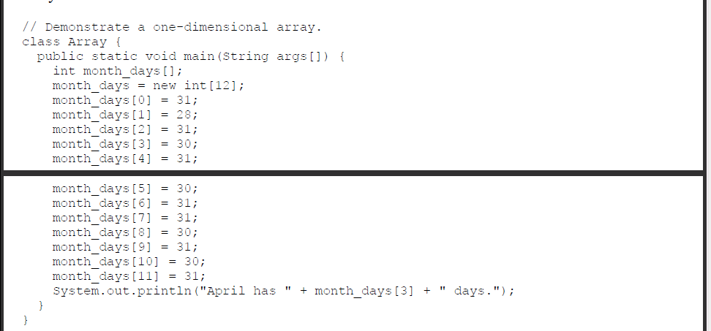
Example program

Slide 12
Example program 2
// StudentArray.java: store integers in arrays and access
public class StudentArray{
public static void main(String[] args) {
int[] students;
students = new int[7];
System.out.println("Array Length="+students.length);
for ( int i=0; i < students.length; i++)
students[i] = 2*i;
System.out.println("Values Stored in Array:");
for ( int i=0; i < students.length; i++)
System.out.println(students[i]);
}
}

Slide 13
Example program 3
// StudentArray.java: store integers in arrays and access
public class StudentArray{
public static void main(String[] args) {
int[] students = {55, 69, 70, 30, 80};
System.out.println("Array Length = " + students.length);
System.out.println("Values Stored in Array:");
for ( int i=0; i < students.length; i++)
System.out.println(students[i]);
}
}

Slide 14
Multi-Dimensional arrays
Multidimensional arrays are arrays of arrays with each element of the array holding the reference of other array.
A multidimensional array is created by appending one set of square brackets ([]) per dimension.

Slide 15
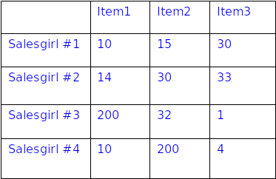
2-D Arrays
Two dimensional arrays allows us to store data that are recorded in table. For example:
Table contains 12 items, we can think of this as a matrix consisting of 4 rows and 3 columns.

Slide 16
2-D Array Manipulation
Declaration:
int myArray [][];
Creation:
myArray = new int[4][3]; // OR
int myArray [][] = new int[4][3];
Initialization:
Single Value;
myArray[0][0] = 10;
Multiple values:
int tableA[2][3] = {{10, 15, 30}, {14, 30, 33}};
int tableA[][] = {{10, 15, 30}, {14, 30, 33}};

Slide 17
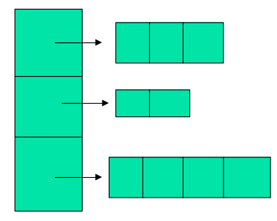
Variable size 2-d arrays
Java treats multidimensional arrays as “arrays of arrays”. It is possible to declare a 2D arrays as follows:
int a[][] = new int [3][];
a[0]= new int [3];
a[1]= new int [2];
a[2]= new int [4];

Slide 18
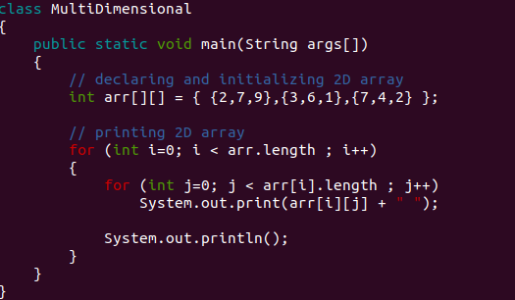
Example program

Slide 19
THANK YOU!

